Slide 1

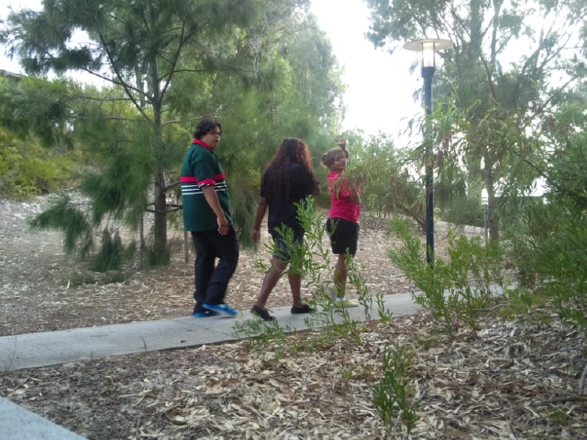



The Build Project - Yarning for Wellness
Escare Youth Service. Term 1 & 2, 2013

Slide 2


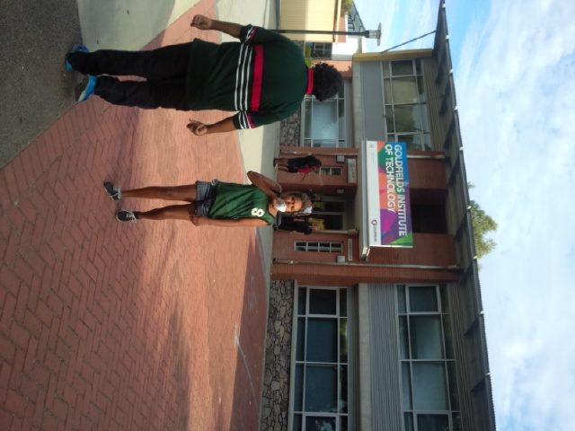
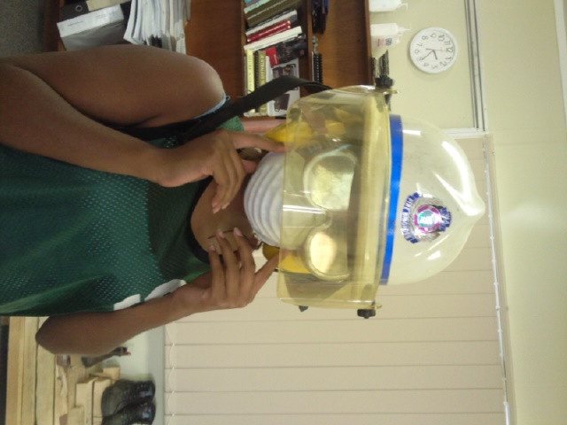
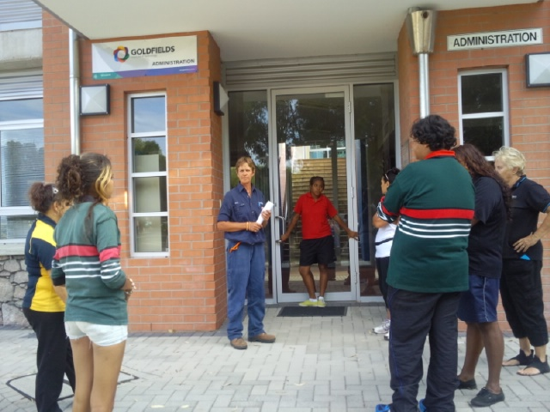
WEEK 1- 5th January 2013
The first day we arrived at the Goldfields Institute of Technology we had a tour of the campus and the began learning all about PPE (Personal Protection Equipment) and our new project for Term 1 & 2 of 2013!

Slide 3
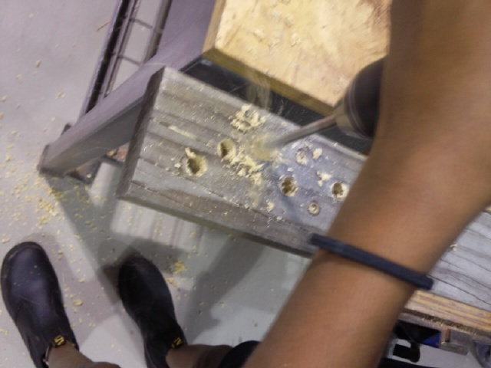
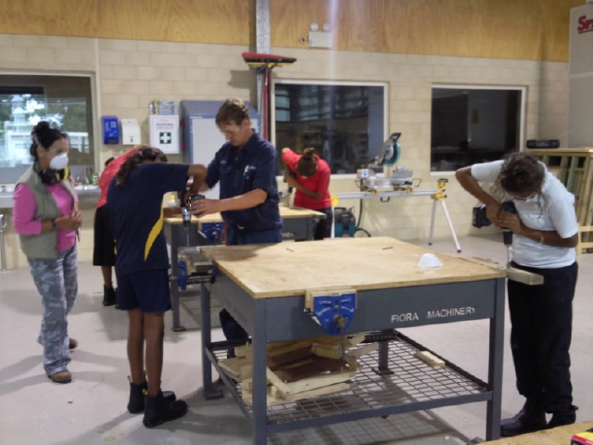
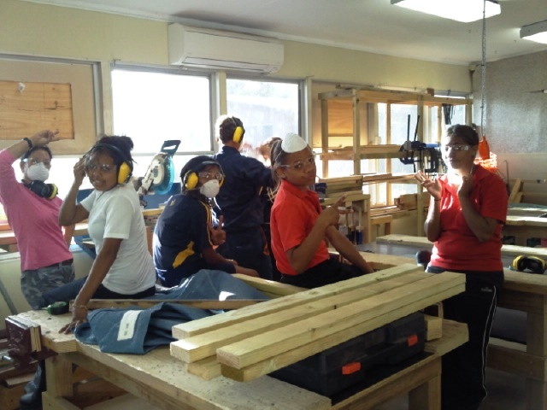
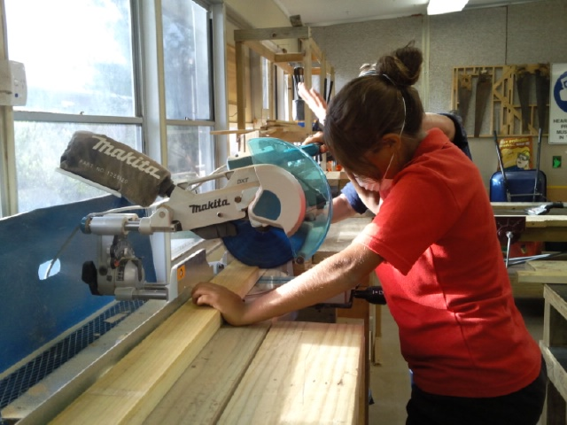
WEEK 2- 19th January &
WEEK 3- 12th March 2013
In weeks 2 & 3 we started cutting the wood for our table and learning how to use the drill properly. The drills were great fun, but we made sure we were safe.
When we cut the wood It took ages and was a bit scary using the saw, but everyone gave it a try at least once anyway!

Slide 4
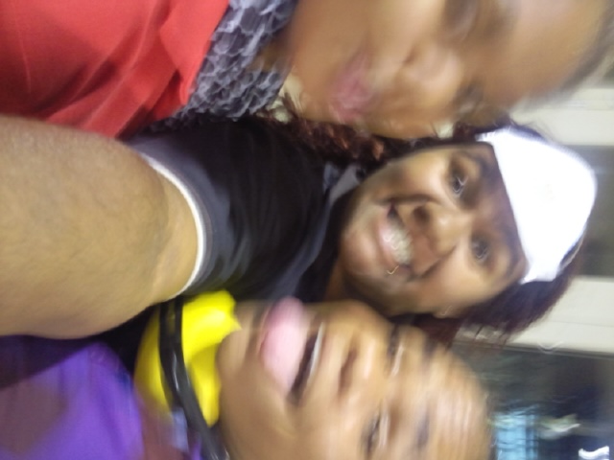
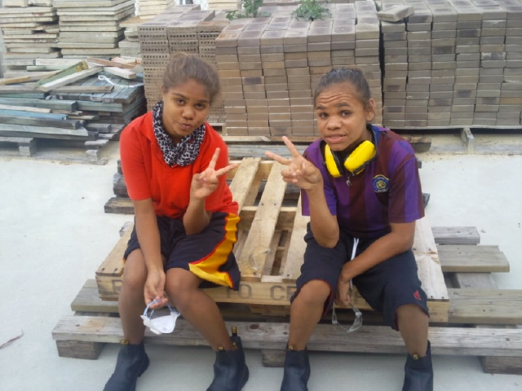
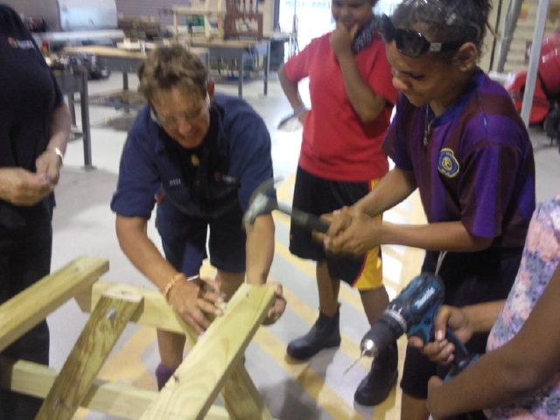
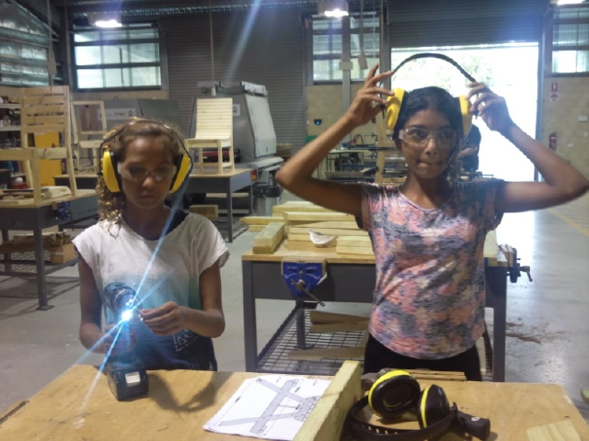
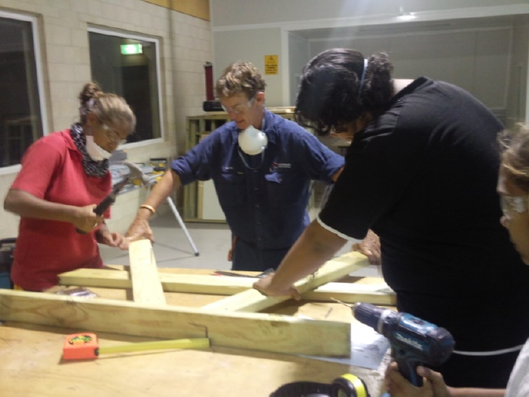
WEEK 4- 19th March 2013
In week 4 we started to put our table together. We were so excited to see all our hard work coming together and had the best time smashing nails into the timber. We took it turns to drill holes and hammer nails while everyone else held the right pieces of wood in place. It was a good day.

Slide 5
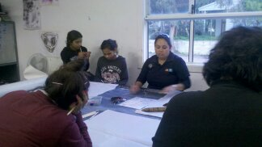
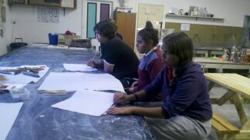
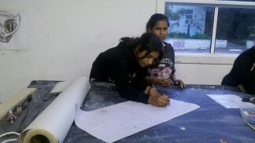
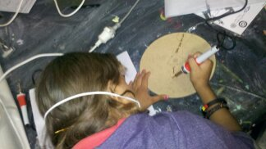
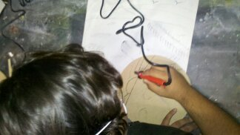
WEEK 5- 13th June 2013
Week 5 made us a little bit nervous because we were going to another new place with new people again. Most of us new Aunty Jennell who was helping with the art, but we didn’t know Allira from The Cannery. We came up with some great ideas on paper for what we wanted to burn on the table and then practiced our ideas on wooden door plaques we got to take home.
It wasn't long before we thought Allira was great and asked her to take us walking and exploring around the Cannery.

Slide 6
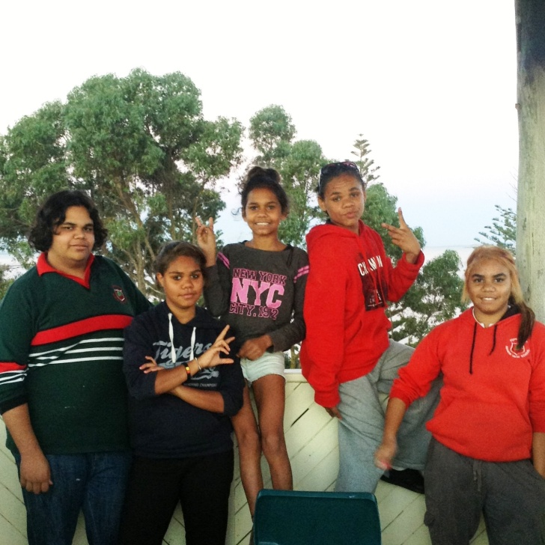
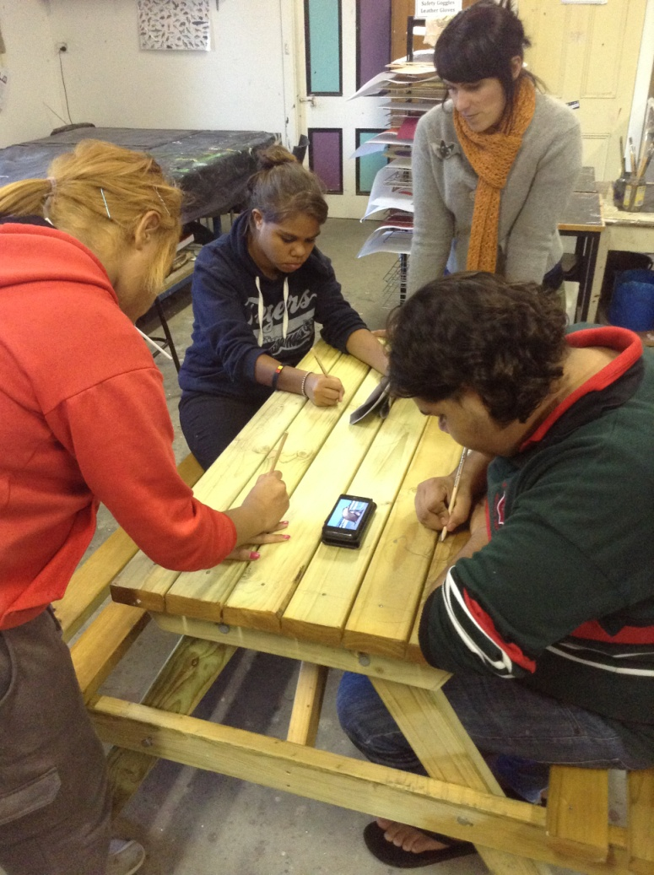
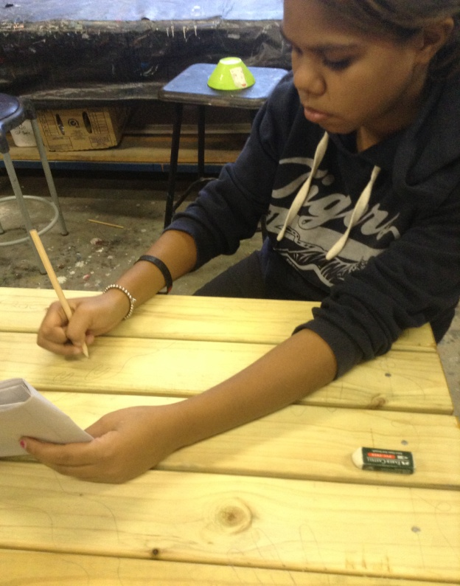
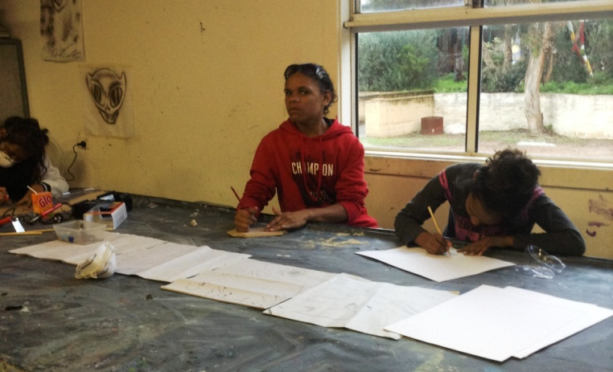
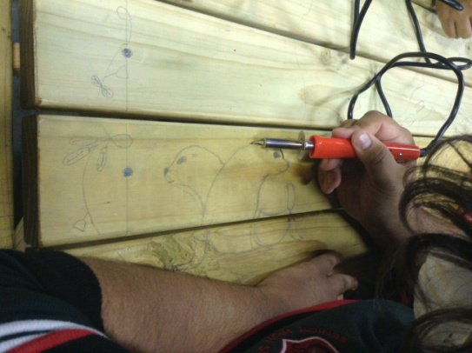
WEEK 6- 27th June 2013
Week 6 we got to draw on the table! All our ideas planning and hard work were paying off. It was great to get our final art piece down and begin burning it in place.
We all had a go at everything, and Allira said some of us had “real natural talent” when it comes to art and design.
What a huge boost in self-esteem that gave us!

Slide 7
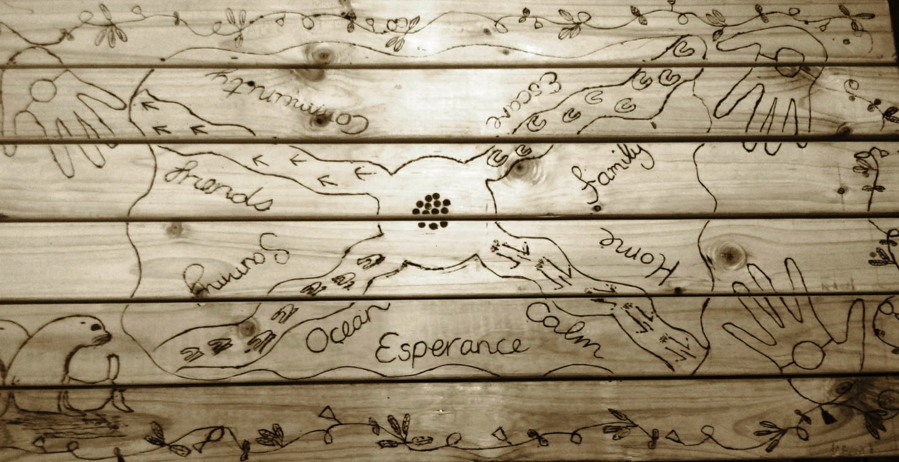
WEEK 7- 4th July 2013
Sadly it was almost over. In this last week we finished all the burning, sanded away the pencils marks, applied the plaque with all our names on it, had an article in the Esperance Express Newspaper and said our farewells to an awesome project.
We all had such a blast with this project and have already started asking Semara if we can do it again!
We’d like to thank the Community Arts Network of WA, Healthway, Relationships Australia, the Goldfields Institute of Technology, the Cannery Arts Centre and Jennell Reynolds for making this all possible.

